Slide 1
Divide and conquer algorithm
Presented By:
Sampada Kharel,191723
Apsara B.K,191704

Slide 2
Contents
Introduction
Types
Pseudocode
Examples
Pros and cons

Slide 3
Introduction
Divide and Conquer is an algorithmic pattern. In algorithmic methods, the design is to take a dispute on a huge input, break the input into minor pieces, decide the problem on each of the small pieces, and then merge the piecewise solutions into a global solution. This mechanism of solving the problem is called the Divide & Conquer Strategy.
Divide and Conquer algorithm consists of a dispute using the following three steps.
Divide the original problem into a set of subproblems.
Conquer: Solve every subproblem individually, recursively.
Combine: Put together the solutions of the subproblems to get the solution to the whole problem.

Slide 4
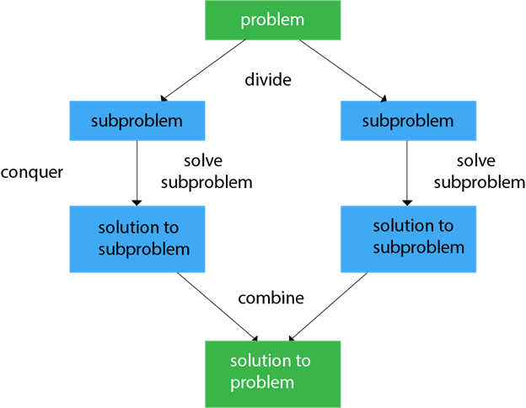

Slide 5
Examples: some specific computer algorithm based on divide and conquer algorithm.
Binary search
Sorting (merge sort, quick sort)
Tower of Hanoi
Maximum and minimum problem
Binary search is a searching algorithm used in a sorted array by repeatedly dividing the search interval in half. The idea of binary search is to use the information that the array is sorted and reduce the time complexity to O(Log n).

Slide 6
Binary Search Algorithm: The basic steps to perform Binary Search are:
Begin with the mid element of the whole array as a search key.
If the value of the search key is equal to the item then return an index of the search key.
Or if the value of the search key is less than the item in the middle of the interval, narrow the interval to the lower half.
Otherwise, narrow it to the upper half.
Repeatedly check from the second point until the value is found or the interval is empty.
Binary Search Algorithm can be implemented in the following two ways
Iterative Method
Recursive Method

Slide 7
Recursive Method (The recursive method follows the divide and conquer approach)
binarySearch(arr, x, low, high)
if low > high
return False
else
mid = (low + high) / 2
if x == arr[mid]
return mid
else if x > arr[mid] // x is on the right side
return binarySearch(arr, x, mid + 1, high)
else // x is on the left side
return binarySearch(arr, x, low, mid - 1)

Slide 8
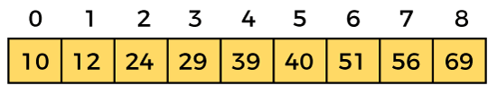
The recursive method of binary search follows the divide and conquer approach.
Let the elements of array are -
Let the element to search is, K = 56
We have to use the below formula to calculate the mid of the array -
mid = (beg + end)/2
So, in the given array -
beg = 0
end = 8
mid = (0 + 8)/2 = 4. So, 4 is the mid of the array.

Slide 9
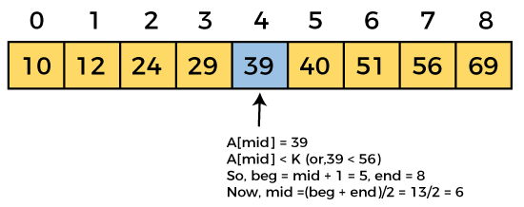
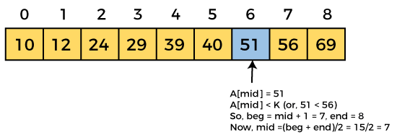

Slide 10
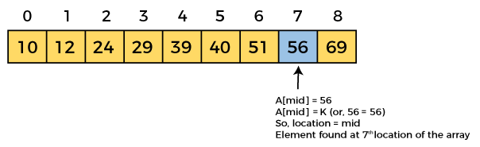
Binary Search complexity
Best Case Complexity - In Binary search, best case occurs when the element to search is found in first comparison, i.e., when the first middle element itself is the element to be searched. The best-case time complexity of Binary search is O(1).
Average Case Complexity - The average case time complexity of Binary search is O(logn).
Worst Case Complexity - In Binary search, the worst case occurs, when we have to keep reducing the search space till it has only one element. The worst-case time complexity of Binary search is O(logn).

Slide 11
Quicksort: It is the most efficient sorting algorithm, which is also known as partition-exchange sort. It starts by selecting a pivot value from an array followed by dividing the rest of the array elements into two sub-arrays. The partition is made by comparing each of the elements with the pivot value. It compares whether the element holds a greater value or lesser value than the pivot and then sort the arrays recursively.
Merge Sort: It is a sorting algorithm that sorts an array by making comparisons. It starts by dividing an array into sub-array and then recursively sorts each of them. After the sorting is done, it merges them back.

Slide 12
Algorithm
step 1: start
step 2: declare array and left, right, mid variable
step 3: perform merge function.
if left > right
return
mid= (left+right)/2
mergesort(array, left, mid)
mergesort(array, mid+1, right)
merge(array, left, mid, right)
step 4: Stop

Slide 13
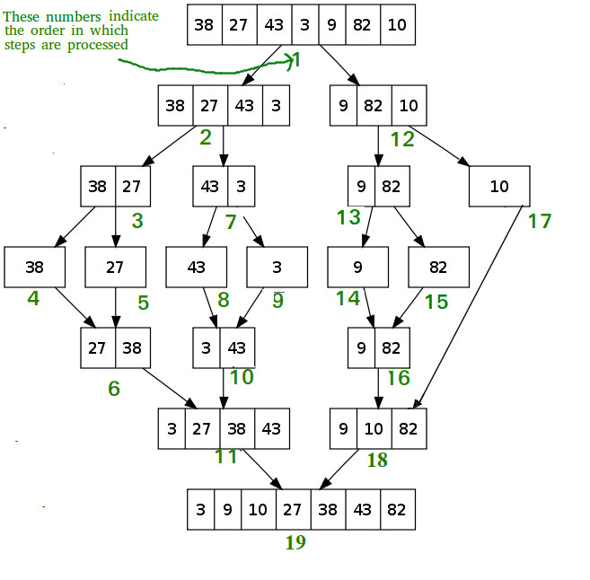

Slide 14
The time complexity of Merge Sort isθ(Nlog(N)) in all 3 cases (worst, average, and best) as merge sort always divides the array into two halves and takes linear time to merge two halves.

Slide 15
Advantages of Divide and Conquer
Divide and Conquer tend to successfully solve one of the biggest problems, such as the Tower of Hanoi, a mathematical puzzle. It is challenging to solve complicated problems for which you have no basic idea, but with the help of the divide and conquer approach, it has lessened the effort as it works on dividing the main problem into two halves and then solve them recursively. This algorithm is much faster than other algorithms.
It efficiently uses cache memory without occupying much space because it solves simple subproblems within the cache memory instead of accessing the slower main memory.

Slide 16
Disadvantages of Divide and Conquer
Since most of its algorithms are designed by incorporating recursion, so it necessitates high memory management.
An explicit stack may overuse the space.
It may even crash the system if the recursion is performed rigorously greater than the stack present in the CPU.

